Slide 1


Vidhoor AI
Democratizing Justice through High-Speed Legal Intelligence
Idea Submission: Round 1

Slide 2



Executive Summary
Our Mission
Core Advantage
To bridge the gap between complex Indian legal frameworks and common citizens, while empowering law students and firms with an intelligent research copilot.
Ultra-low latency inference (2,350 tokens/sec) combined with localized RAG over 851+ pages of specialized Indian law books.

Slide 3


Problem Statement
Complex Jargon: Average citizens cannot comprehend dense laws like the new BNS or BNSS.
Research Inefficiency: Professionals spend ~30% of their time on manual cross-referencing.
Privacy Concerns: Generic AI tools pose data leakage risks for sensitive case files.

Slide 4
Literature Survey & Gap Analysis
Feature | Generic AI | Legacy Databases | Vidhoor Legal AI
Legal Context | Low (Hallucinations) | High (Text Search) | Expert (RAG Optimized)
Inference Speed | Variable | Manual Search | 2,350 tokens/sec
Privacy (PII/E2EE) | Limited | Standard Login | Enterprise-Grade
Accessibility | Technical | Too Dense | Simplified Plain Language

Slide 5
The Intelligent Bridge
Vidhoor AI acts as a sophisticated translator, converting 160 years of legal evolution into real-time, actionable insights for every Indian.

Slide 6
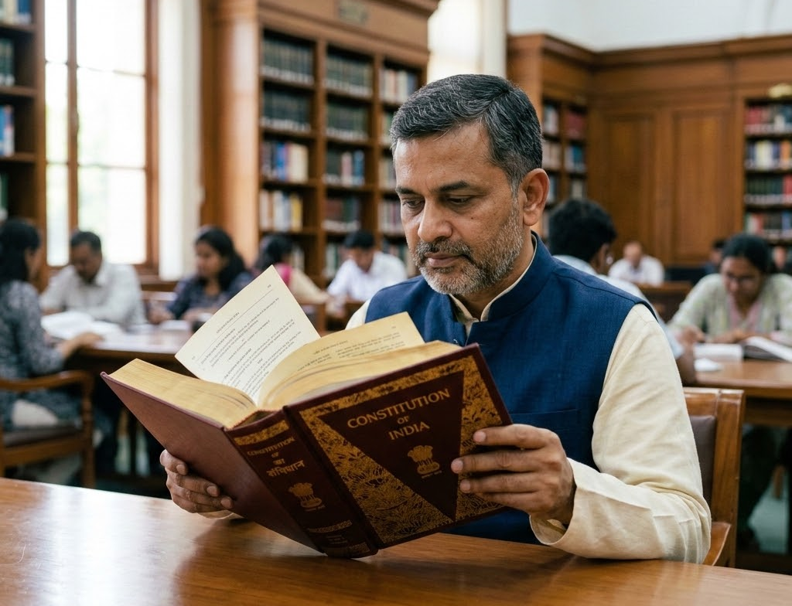


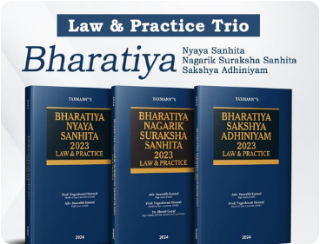

Core Knowledge Base & Ingestion
Constitution of India
BNS / BNSS / BSA
IT & Data Privacy
The foundational legal document and citizen rights.
The complete modern criminal justice statutes (2024).
DPDP Act and IT Law 2000 compliance training.

Slide 7






Proposed Technology Stack
Inference Engine
Vector Storage
PII Redaction
Llama 3.1 8B model hosted on Cerebras for ultra-low latency.
Oracle Autonomous DB with Hybrid Search capabilities.
Automated security layer integrated into the RAG workflow.

Slide 8

Inference Velocity
2,350
Tokens Per Second Delivery
Utilizing Cerebras acceleration, Vidhoor AI eliminates the "latency barrier," allowing legal professionals to query massive case histories instantly with real-time streaming results.

Slide 9

SaaS Revenue & Business Model
■ B2B SaaS (50%): Enterprise subscription for Law Firms.
■ Academic (30%): Subscription model for Law Students.
■ B2C Basic (20%): Freemium tier for public legal literacy.

Slide 10
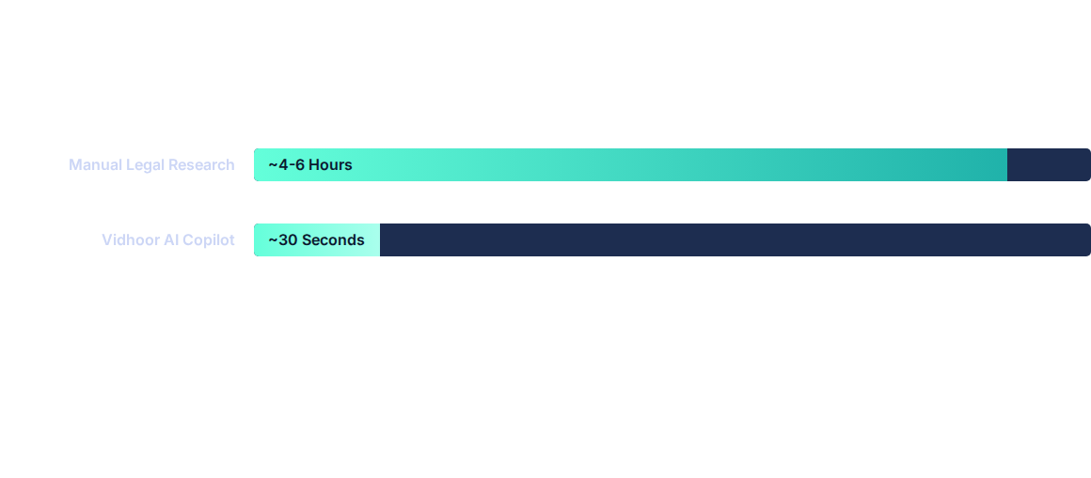
Expected Impact: Time Savings
Based on testing against 851 pages of Indian legal statutes and indexed precedents.

Slide 11




Project Roadmap
Ingestion
RAG Build
Privacy Dev
Scale Out
Data cleaning of 851 pages of core Indian statutes.
Establishing Hybrid Search on Oracle Autonomous DB.
Integrating PII redaction & E2EE security protocols.
Deployment of Academic tier and B2B SaaS platform.

Slide 12






Image Sources
https://speakwrite.com/wp-content/smush-webp/2025/03/Lawyer-Stress1.png.webp
Source: speakwrite.com
https://tile.loc.gov/image-services/iiif/service:ll:llscd:57026883:00010000/full/pct:25/0/default.jpg
Source: www.loc.gov
https://mandjservice.com/cdn/shop/files/law-and-practice-series-bharatiya-nyaya-sanhita-bns-or-bharatiya-nagarik-suraksha-sanhita-bnss-or-bharatiya-sakshya-adhiniyam-bsa-or-set-of-3-books_512x518.jpg?v=1744955697
Source: mandjservice.com
https://png.pngtree.com/png-vector/20260330/ourlarge/pngtree-cyber-security-padlock-shield-icon-protects-data-with-green-neon-light-png-image_18979291.webp
Source: pngtree.com
https://static.vecteezy.com/system/resources/thumbnails/079/422/855/small_2x/abstract-flowing-data-fiber-optic-light-trail-digital-network-stream-technology-background-blue-light-futuristic-communication-concept-with-glowing-lines-particles-moving-through-dark-space-motion-free-video.jpg
Source: www.vecteezy.com
https://images.stockcake.com/public/a/b/f/abf5ec05-faa4-405f-8f75-8cfba45cfd9f_large/legal-technology-concept-stockcake.jpg
Source: stockcake.com

